Slide 1
JAVA PROJECT • BATCH 4
Rooftop Solar
Energy Monitor
A simple Java application to calculate solar power and report panel status.
K. Shanmuk • 2620040047
D. Sri Pavan Ranga • 2620040106
K. Sai Varshith Krishna • 2620040129
PROJECT PRESENTATION

Slide 2
01 / OVERVIEW
02
Abstract
The Rooftop Solar Energy Monitor is a Java console program that accepts voltage and current, calculates electrical power, and displays a simple performance status.
Input
Voltage (V) and current (A)
Calculation
The project demonstrates core Java programming through input, conditions, methods, strings, exception handling, and a collection.
Power = Voltage × Current
Output
Power reading, status, and panel record
ROOFTOP SOLAR ENERGY MONITOR • JAVA PROJECT

Slide 3
02 / WHY THIS PROJECT
03
Problem Statement & Objectives
Problem
Objective
Solar panel readings need a simple way to convert voltage and current into power and communicate the result clearly.
Build a beginner-friendly Java program that calculates power, classifies the reading, and displays panel information.
PROJECT GOALS
Accept voltage and current from the user.
Calculate power using P = V × I.
Display a readable status and panel details.

Slide 4
03 / SYSTEM FLOW
04
How the Program Works
01
02
03
04
05
Read input
Calculate
Classify
Display
Record
→
→
→
→
Voltage & current
P = V × I
Apply if–else
Power & status
Store panel in list
Current implementation processes one voltage–current reading and adds one panel object to an ArrayList.
ROOFTOP SOLAR ENERGY MONITOR • JAVA PROJECT

Slide 5
04 / CORE CALCULATION
05
Power Calculation & Status Logic
Current code: Good
ELECTRICAL POWER
Displayed when power is greater than 400 W.
P = V × I
Current code: Low
Power (W) = Voltage (V) × Current (A)
Displayed when power is 400 W or less.
Recommended project thresholds:
NORMAL ≥ 500 W • MODERATE 300–499.99 W • LOW POWER < 300 W
ROOFTOP SOLAR ENERGY MONITOR • JAVA PROJECT

Slide 6
05 / PROGRAM STRUCTURE
06
Main Components
Solar class
Main method
showPower()
Stores panelId and power. Its constructor assigns values to these fields.
Reads input, calculates power, runs the status check, and prints results.
A static method that receives the calculated power and displays it.
Data flow
User input → power calculation → status message → method output → Solar object stored in ArrayList
ROOFTOP SOLAR ENERGY MONITOR • JAVA PROJECT

Slide 7
06 / JAVA CONCEPTS
07
Concepts Demonstrated in the Current Code
Datatypes & operators
Scanner
double, int, multiplication
Reads voltage and current
Control flow
Methods
if–else and enhanced for loop
showPower(double p)
Strings
Exception handling
toUpperCase(), length()
try–catch with integer parsing
ArrayList
Class & constructor
Stores a Solar panel object
Solar class and Solar(...) constructor
Note: ArrayList is a collection; it is not the same as a Java array.
ROOFTOP SOLAR ENERGY MONITOR • JAVA PROJECT

Slide 8
07 / IMPROVEMENTS
08
Concepts Still to Add for the Full Requirement
1. Arrays
2. Inheritance
3. Overloading / overriding
Use a double[] or 2D array to store multiple panel readings.
Create a SolarPanel parent class and a child class using extends.
Add a second showPower() signature or demonstrate an overridden method.
ROOFTOP SOLAR ENERGY MONITOR • JAVA PROJECT

Slide 9
08 / DEMONSTRATION
09
Sample Console Run
Enter voltage: 24
Enter current: 20
Status: Good
Total Power: 480.0W
Parsed value: 100
Upper: SOLAR SYSTEM
Length: 12
--- Collection List ---
Panel: P1 Power: 480.0W
Input
24 V and 20 A
Calculated power
24 × 20 = 480 W
Illustrative output
ROOFTOP SOLAR ENERGY MONITOR • JAVA PROJECT

Slide 10
09 / EVALUATION
10
Benefits & Current Limitations
Benefits
Limitations
• Simple console interaction
• Quick power calculation
• Readable output
• Demonstrates core Java syntax
• Only one reading per run
• Current threshold differs from the project specification
• No array-based panel analysis
• No total/average across multiple panels
Next steps
Accept readings for multiple panels.
Calculate total and average power.
Apply the agreed NORMAL / MODERATE / LOW POWER thresholds.
ROOFTOP SOLAR ENERGY MONITOR • JAVA PROJECT

Slide 11
10 / SUMMARY
11
Conclusion & Future Scope
The project shows how Java can turn basic electrical inputs into a clear power reading and status message.
SOLAR DASHBOARD
POWER
480 W
Use arrays for multiple panel readings.
STATUS
GOOD
Add inheritance and method overloading/overriding.
PANELS
01
Include total and average power calculations.
Improve input validation and error messages.
ROOFTOP SOLAR ENERGY MONITOR • JAVA PROJECT

Slide 12
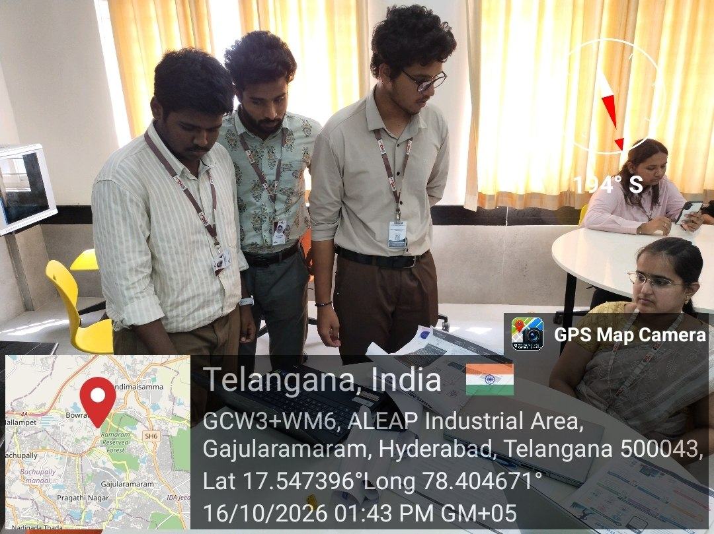
12 / SUBMISSION
13
GitHub Link & Geo-Tag Photo
GitHub repository
Geo-tag photo
https://github.com/kandoorishanmukharigupta-jpg/KLH-PSPJ-S16-TEAM-NO.4
ROOFTOP SOLAR ENERGY MONITOR • JAVA PROJECT

